Slide 1
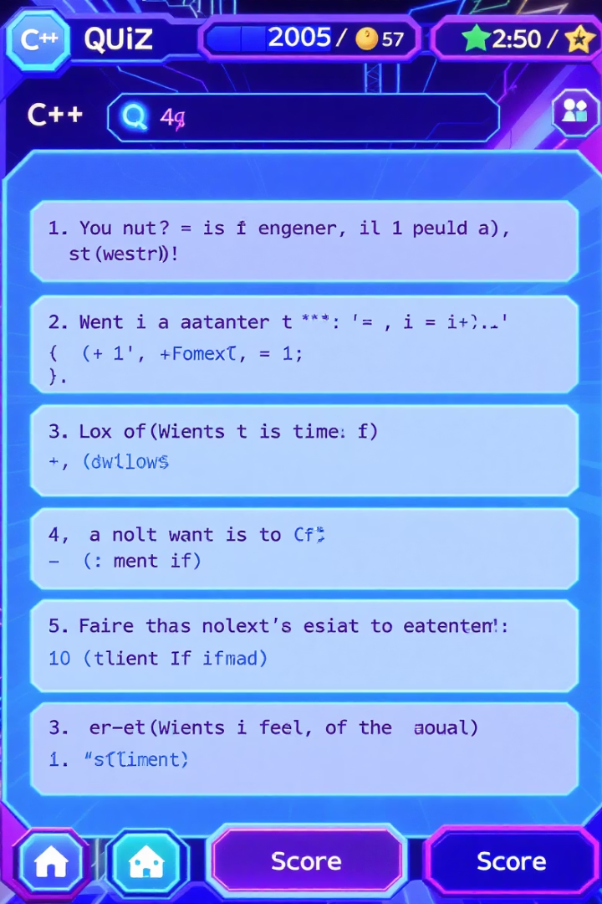
C++ Quiz Game: Interactive Learning for Developers
An interactive command-line quiz application built in C++ to test programming knowledge. Features include randomised questions, timing, score tracking, and detailed user history.

Slide 2





Core Technologies & Libraries
Standard C++ Libraries
Windows API Integration
Utilises iostream, string, algorithm, and chrono libraries for core functionality.
Implements windows.h for console manipulation and file system operations.
File Handling
Timing System
Employs fstream for persistent user history and performance tracking.
Uses chrono library to measure and record quiz completion time.

Slide 3





Development Timeline
Requirements Gathering
Identified core quiz functionality and user experience requirements.
System Design
Created class architecture and defined data structures for questions and scoring.
Implementation
Developed core functionality with focus on randomisation and feedback.
Testing & Refinement
Conducted user testing and optimised performance and UI elements.

Slide 4
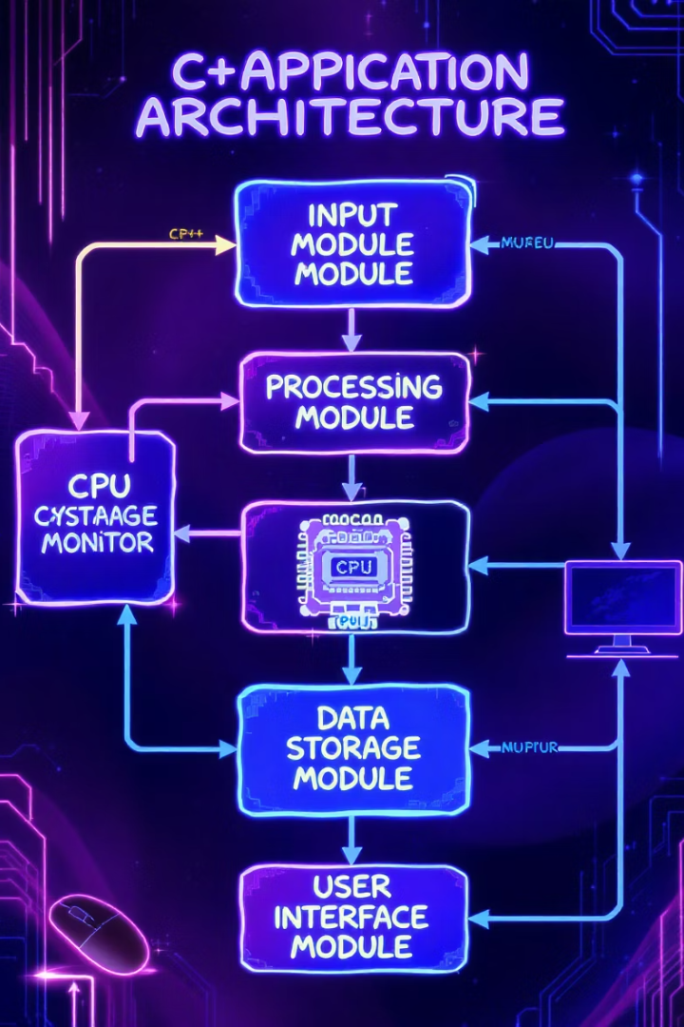




Application Architecture
User Authentication
Validates username input and manages user history files.
Question Randomisation
Shuffles questions for unique quiz experiences each time.
Answer Processing
Validates user inputs and provides immediate feedback.
Result Recording
Stores detailed quiz performance in user-specific files.

Slide 5








Key Code Components
Question Management
User Interface
LoadQuestions() and ShuffleQuestion() methods handle question bank operations.
SetColor() and CentredMessage() provide a clean console interface.
Data Persistence
Timing System
WriteResultsToFile() and WriteQuestionDetailsToHistory() maintain records.
StartTimer(), StopTimer(), and GetElapsedTime() track quiz duration.

Slide 6
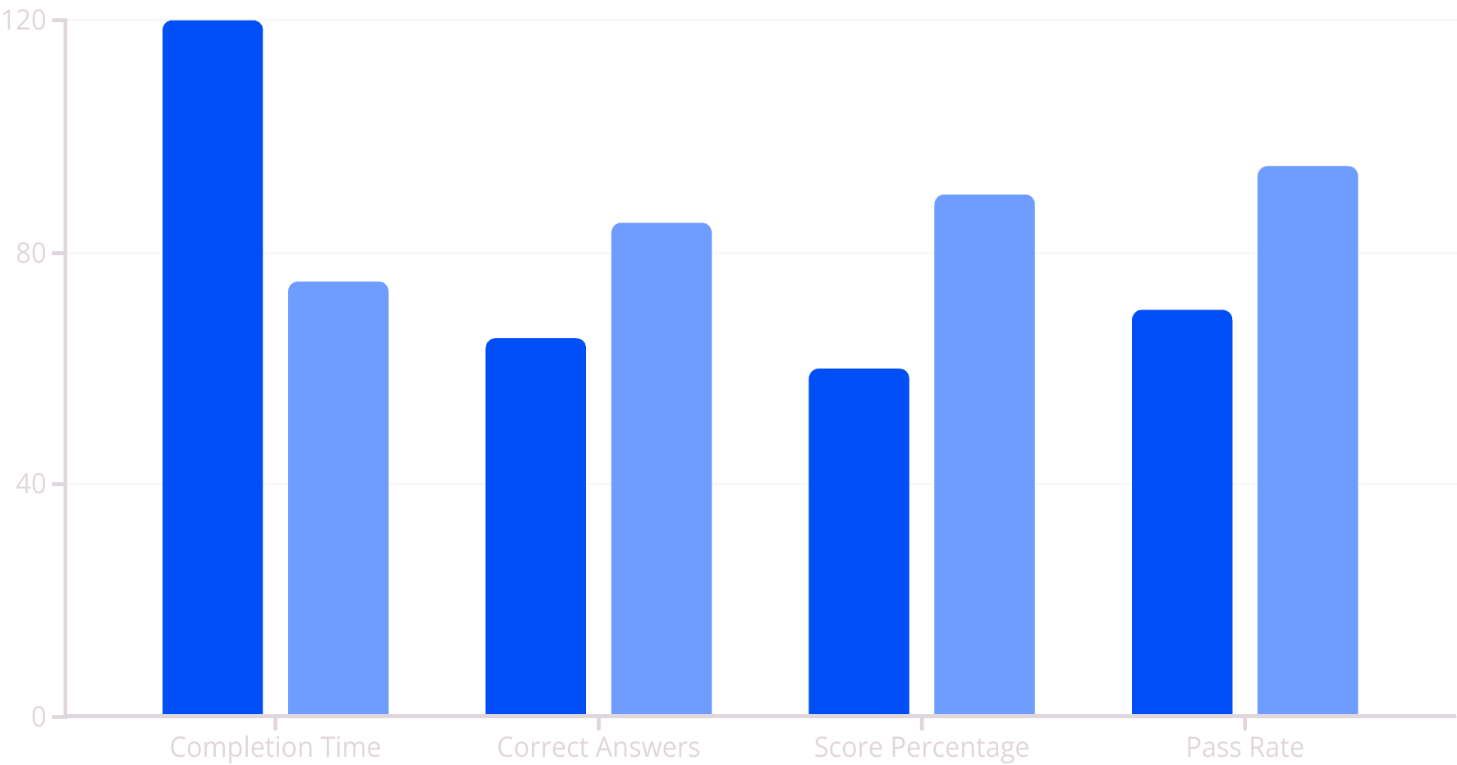
Performance Results
Basic Users
Experienced Users
Testing revealed strong performance across user types. Experienced C++ developers completed quizzes 40% faster with significantly higher accuracy.

Slide 7

Educational Impact & Applications
C++ Skill Assessment
Interview Preparation
Provides immediate feedback on C++ knowledge gaps. Users can track progress through repeated attempts.
Simulates technical interview questions. Timed format mirrors real assessment conditions.
Teaching Tool
Self-Directed Learning
Instructors can customise question banks. Performance metrics help identify common misconceptions.
Learners can practice at their own pace. Detailed history files support analysis of improvement over time.

Slide 8



Sustainable Development Goals Impact
Quality Education (SDG 4)
Provides accessible programming education tools
Industry & Innovation (SDG 9)
Develops technical skills for the digital economy
Partnerships (SDG 17)
Open-source code encourages collaborative improvement
This application supports SDG objectives by democratising access to programming education, reducing barriers to technical skill development, and fostering collaborative innovation through open-source sharing.

